Slide 1
Scenario
You’re part of the growing security team at a company for sneaker enthusiasts and collectors. The business is preparing to launch a mobile app that makes it easy for their customers to buy and sell shoes.
You are performing a threat model of the application using the PASTA framework. You will go through each of the seven stages of the framework to identify security requirements for the new sneaker company app.

Slide 2
PASTA worksheet
Description: Our application should seamlessly connect sellers and shoppers. It should be easy for users to sign-up, log in, and manage their accounts. Data privacy is a big concern for us. We want users to feel confident that we’re being responsible with their information.
Buyers should be able to directly message sellers with questions. They should also have the ability to rate sellers to encourage good service. Sales should be clear and quick to process. Users should have several payment options for a smooth checkout process. Proper payment handling is really important because we want to avoid legal issues.
Stages | Sneaker company
I. Define business and security objectives The main goal of Stage I of the PASTA framework is to understand why the application was developed and what it is expected to do. For example, how does the app make the business money? Understanding the answer to these questions helps guide the detailed work that will follow. (typically requires gathering input from many individuals at a business) | Make 2-3 notes of specific business requirements that will be analyzed. ● Will the app process transactions? ● Does it do a lot of back-end processing? ● Are there industry regulations that need to be considered? A shopping application like this will need to process payments. Based on this description, we know certain technologies are required to keep information private and secure. Users can create member profiles internally or by connecting external accounts. The app must process financial transactions. The app should be in compliance with PCI-DSS.

Slide 3
PASTA worksheet
In Stage II, the technological scope of the project is defined. Normally, the application development team is involved in this stage because they have the most knowledge about the code base and application logic. Your responsibility as a security professional would be to evaluate the application's architecture for security risks.
For example, the app will be exchanging and storing a lot of user data. These are some of the technologies that it uses:
Application programming interface (API): An API is a set of rules that define how software components interact with each other. In application development, third-party APIs are commonly used to add functionality without having to program it from scratch.
Public key infrastructure (PKI): PKI is an encryption framework that secures the exchange of online information. The mobile app uses a combination of symmetric and asymmetric encryption algorithms: AES and RSA. AES encryption is used to encrypt sensitive data, such as credit card information. RSA encryption is used to exchange keys between the app and a user's device.
SHA-256: SHA-256 is a commonly used hash function that takes an input of any length and produces a digest of 256 bits. The sneaker app will use SHA-256 to protect sensitive user data, like passwords and credit card numbers.
Structured query language (SQL): SQL is a programming language used to create, interact with, and request information from a database. For example, the mobile app uses SQL to store information about the sneakers that are for sale, as well as the sellers who are selling them. It also uses SQL to access that data during a purchase.
Stages | Sneaker company
II. Define the technical scope | Understand the attack surface List of technologies used by the application: API, PKI, AES, SHA-256, SQL Understand their dependencies Write 2-3 sentences (40-60 words) that describe why you choose to prioritize that technology over the others. APIs facilitate the exchange of data between customers, partners, and employees, so they should be prioritized. They handle a lot of sensitive data while they connect various users and systems together. However, details such as which APIs are being used should be considered before prioritizing one technology over another. So, they can be more prone to security vulnerabilities because there’s a larger attack surface.

Slide 4
PASTA worksheet
Data flow diagram
Note: This data flow diagram represents a single process. Data flow diagrams for an application like this are normally much more complex.
Product search
process
User
Searching for sneakers for sale.
Listings of current inventory.
Database
Stages | Sneaker company
III. Decompose application The objective is to analyze how the application is handling information. Here, each process is broken down. | The sample data flow diagram shows how a typical search request passes through multiple layers. One of the app's processes might be to allow buyers to search the database for shoes that are for sale. Hence, to review here ensuring the MySQL database is using prepared statements when queries are input.

Slide 5
PASTA worksheet
Stage IV is about identifying potential threats to the application. This includes threats to the technologies you listed in Stage II. It also concerns the processes of your data flow diagram from Stage III.
Pro tip: Internal system logs that you will use as a security analyst are good sources of threat intel
Stages | Sneaker company
IV. Threat analysis | List 2 types of threats in the PASTA worksheet that are risks to the information being handled by the application. ● What are the internal threats? ● What are the external threats? ● Injection attacks are common for SQL databases ● Session hijacking is possible because the app communicates cookies between multiple layers Apps authentication system could be attacked with a virus. Authentication could also be attacked if a threat actor social engineers an employee.

Slide 6
PASTA worksheet
Here, you need to consider the attack surface of the technologies listed in Stage II.
Pro tip: Resources like the CVE® list and OWASP are useful for finding common software vulnerabilities.
Stages | Sneaker company
V. Vulnerability analysis | List 2 vulnerabilities in the PASTA worksheet that could be exploited. ● Could there be things wrong with the codebase? ● Could there be weaknesses in the database? ● Could there be flaws in the network? The app will use a payment system. The form used to collect credit card information might be vulnerable if it fails to encrypt data. ● Lack of prepared statements can make our SQL database vulnerable to injection attacks ● Broken API token ● Session hijacking is possible if cookies are mishandled between input and output sources.

Slide 7
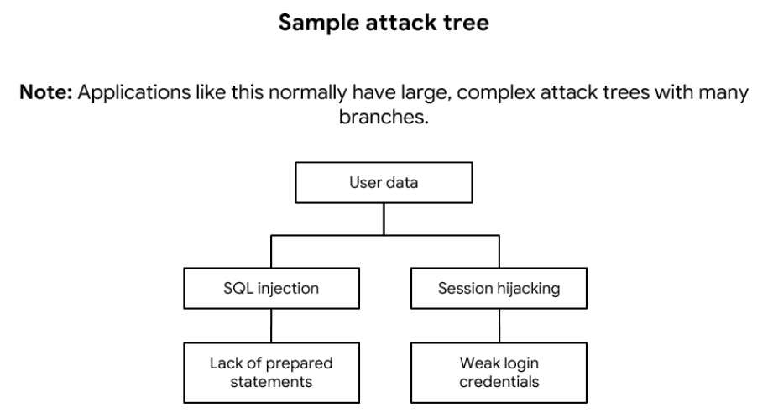
PASTA worksheet
In Stage VI of PASTA, the information gathered in the previous two steps are used to build an attack tree. (link the threats and vulnerabilities to assets)
Stages | Sneaker company
VI. Attack modeling

Slide 8
PASTA worksheet
The final goal is to implement defenses and safeguards that mitigate threats.
Stages | Sneaker company
VII. Risk analysis and impact | List 4 security controls that you’ve learned about that can reduce risk. SHA-256, incident response procedures, password policy, principle of least privilege

